Slide 1
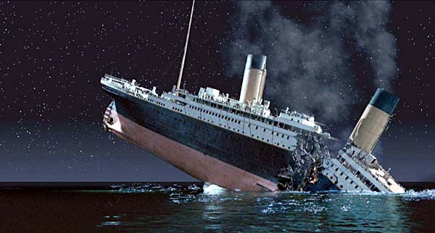
Interesting Conclusions from the Titanic

Slide 2
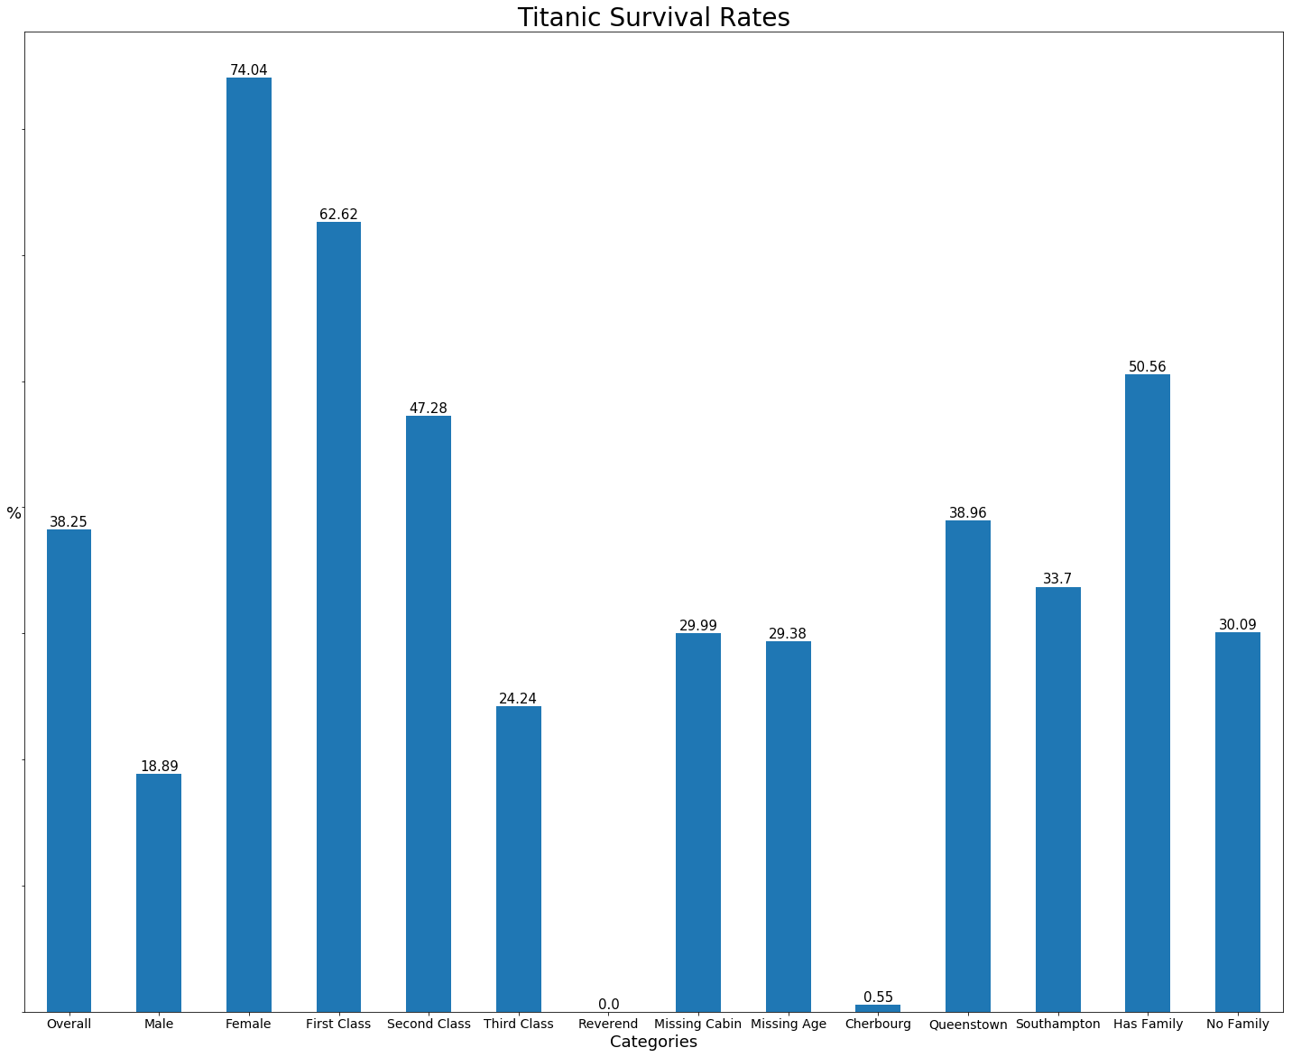

Notes:
Based on the survival rates we know females are awesome
*click female graphic*
And no one likes the French

Slide 3
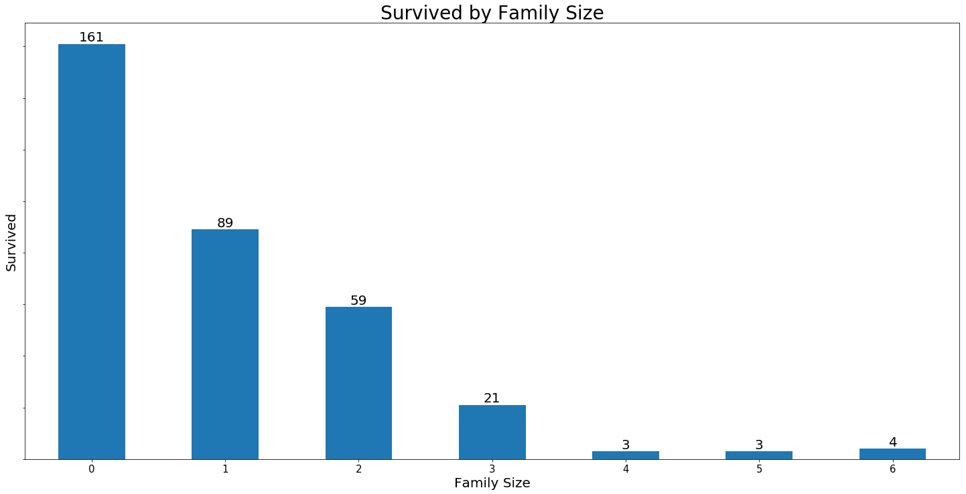

Notes:
The larger your family the more your kids were fighting instead of running for their lives.

Slide 4
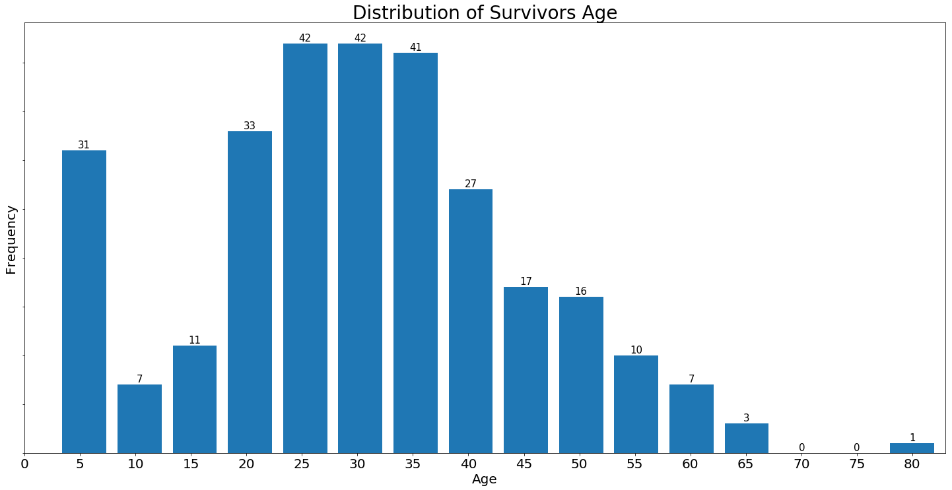
Notes:
What does this tell us?
These parents decided that they had enough of their teenagers and decided they only wanted to keep their preschoolers.

Slide 5
Thank You

